Slide 1
Lecture Note of Pattern Recognition & Machine Learning
I The Role of Probability
Shaoming Zhang

Slide 2
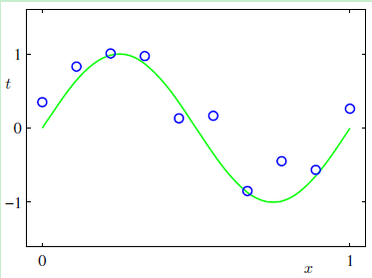
Example: Polynomial Curve Fitting
Given a training set comprising N observations
Together with corresponding observations of the values of t.
N=10，t由sin(2PiX)叠加0均值Gaussian噪声生成，X在[0,1]间均匀采样。
任务：预测新的X对应的t值。
本质：从10个X寻找sin(2PiX)。

Slide 3
What Dr. Bishop said about this problem.
Our goal is to exploit this training set in order to make predictions of the value t of the target variable for some new value X of the input variable.
As we shall see later, this involves implicitly trying to discover the underlying function sin(2PiX).
This is intrinsically a difficult problem as we have to generalize from a finite data set.
Furthermore the observed data are corrupted with noise, and so for a given X there is uncertainty as to the appropriate value for t.
Probability theory, discussed in Section 1.2, provides a framework for expressing such uncertainty in a precise and quantitative manner, and
Decision theory, discussed in Section 1.5, allows us to exploit this probabilistic representation in order to make predictions that are optimal according to appropriate criteria.

Slide 4

最直观的解决方案
——最小二乘 （Least Square）
采用多项式模型“逼近/拟合/回归”数据生成的函数。
Approximation/Fitting/Regression

Slide 5

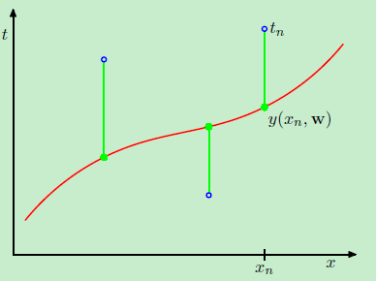
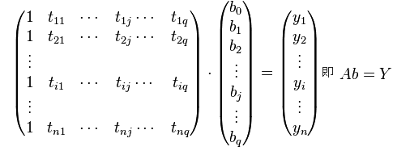

如何求解多项式系数
用每个数据点误差的平方之和来定义逼近/拟合/回归的质量。
关于最小二乘的解的几何意义，后续讨论中再进行。关注A的广义逆。

Slide 6
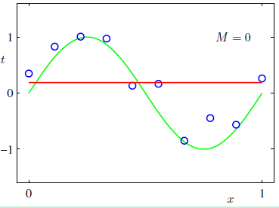
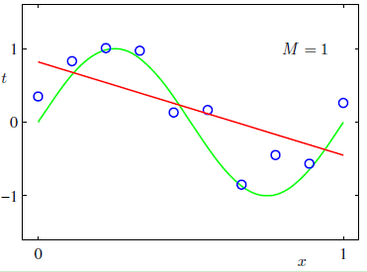
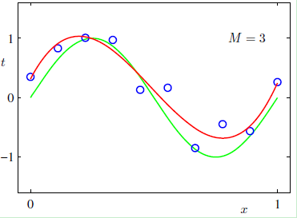
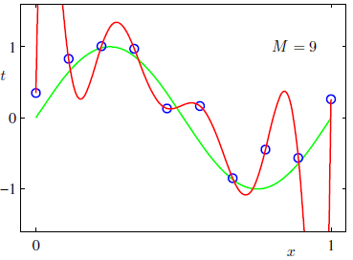
多项式阶数的影响
阶数太低，不能对训练数据进行有效逼近，经验风险过大。
阶数太高，过于贴近训练数据（过拟合），结构风险过大，泛化能力过低。

Slide 7
多项式阶数的影响
阶数太低，不能对训练数据进行有效逼近，经验风险过大。
阶数太高，过于贴近训练数据（过拟合），结构风险过大，泛化能力过低。

Slide 8
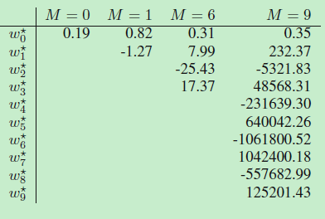
多项式阶数、系数与模型复杂度
阶数越高、系数越大、模型越复杂。
用钉子将一个弹性木条钉在墙上。钉子数量越多，木条需要扭曲的程度越高。

Slide 9

最终解决方案
等式右侧第一项：损失，经验损失，经验风险
等式右侧第二项：模型复杂度
令上式最小即可完成任务，即所谓的岭回归、带有正则化的最小二乘。

Slide 10
What is hiding behind the Least Square?
Answer: The representation of the uncertainty using PROBABILITY
To understand machine learning in the framework of probability, we need to dig deeply into the example and figure out :
How does the probability express the uncertainty and control the
The way to evaluate the loss (Quality of approximation) and
The order of x and the amplitude of the coefficients of the polynomial

Slide 11
参数估计问题
观测数据集 D = (X, t)
Probability of D is P (D).
Our goal is finding an optimal set of parameters w (or a group of coefficients) to obtain a maximum P (D), i.e. maximizing P (D|w)

Slide 12



参数估计问题
The distribution of t ~ N( y(x,w), var )
Assuming the data were drawn independently, then
P (D|w) = N( y(x,w), var )
ln P (D|w) = – + C (doesn’t depend on w)
Maximizing P is equal to minimizing –lnP.
Minimizing – ln P with respect to w is minimizing i.e. Least Square.
P (D|w) is called log Likelihood function
Maximum Likelihood method is equal to Least Square when the noise is additive and obeying Gaussian distribution.

Slide 13
Could we go further?
In the problem of parameter estimation, we have seen how the probability controls the loss function in the maximum likelihood way.
How the probability controls the complexity of the model, i.e. the order of x and the amplitude of the coefficients?

Slide 14
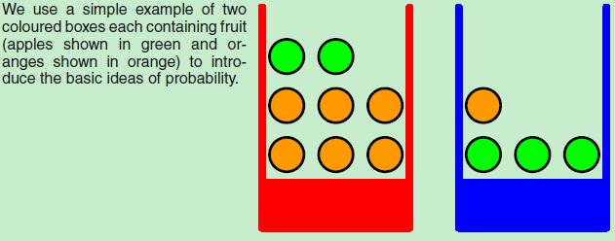
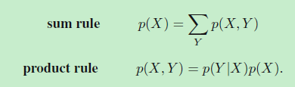
Two key rules of Probability
X（盒子颜色）：红色、蓝色
Y（球的颜色）：绿色、橙色
Example of product rule：
The probability of selecting an orange ball from the red box is equal to the product of
The probability of selecting a orange ball when the selection of box is limited to the red one multiplied by
The probability of selecting the red box

Slide 15

Bayesian probabilities
P(X,Y)=P(Y,X)
P(Y|X)P(X)=P(X|Y)P(Y)
Bayesian probabilities

Slide 16
Introducing a prior distribution over w
In the parameter estimation, w was treated as an determined parameter, which means the probability of selecting any value to w is equal. i.e. there is no uncertainty in w.
Think about the story of hunting.
Considering the uncertainty of w, we need to maximizing P(D, w) =P(D|w)P(w).
P(D|w) is actually the likelihood function.
P(w) is the prior of w, which is need to be introduced.

Slide 17
A story of hunting for understanding prior and posterior
To get the optimal posterior distribution, we can
Improve the estimation of likelihood function using the prior distribution, or
Improve the estimation of prior distribution using the likelihood function.
Both of the above ways are reasonable.

Slide 18



Introducing a prior distribution over w
We assume the distribution of w is Gaussian.
ln P (D|w) = – + C1(doesn’t depend on w)
ln P(w) = – + C2(doesn’t depend on w )
Maximizing P(D, w) =P(D|w)P(w) is equal to minimizing .
P(D|w)P(w) P(w|D), Posterior distribution is proportional to the product of likelihood function and the prior distribution.

Slide 19
Bayesian Curve Fitting
P(D|w)P(w) P(w|D), Posterior distribution is proportional to the product of likelihood function and the prior distribution.

Slide 20

Model Selection
The order of the polynomial controls the number of free parameters in the model and thereby governs the model complexity.
S-fold cross-validation
Akaike information criterion, AIC
Maximizing
Bayesian information criterion, BIC
This section will be discussed extensively in section 4.4.1

Slide 21
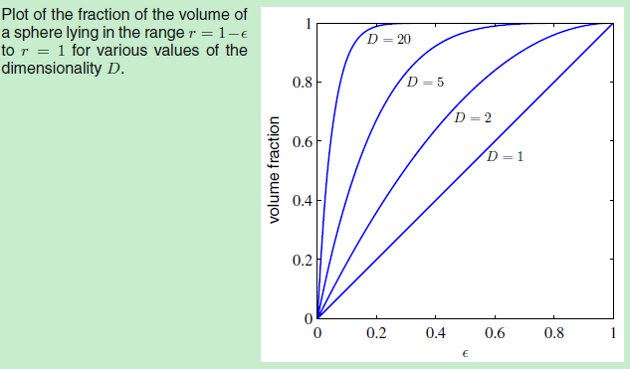

The curse of dimensionality
ε

Slide 22
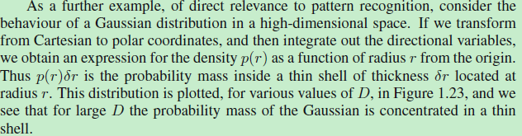

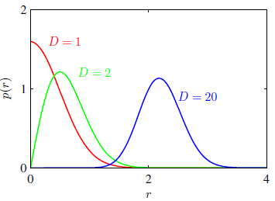

The curse of dimensionality
虽然外围的pdf值较小，但越靠外，每增加单位长度的半径，积分空间增大的倍数越大，导致大部分probability mass在靠近外围的一个薄薄的shell内。

Slide 23
Decision theory
We intuitively would choose the class having the higher posterior probability when we make decisions.
Why?
That depends on our aim! If our aim is
To minimize the chance of assigning samples to the wrong class — The minimum misclassification rate.
To minimize the expected loss — The minimum expected loss.
To classify the samples for which there is little doubt as to be the correct class and leave a human expert to classify the more ambiguous cases. — The reject option.

Slide 24
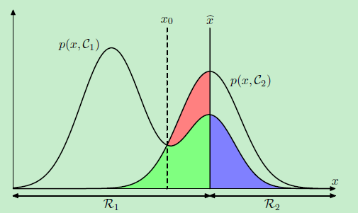

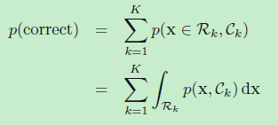
Decision theory
The minimum misclassification rate.
p(x, Ck) = p(Ck|x)p(x)
The factor of p(x) is common to all terms
Each x should be assigned to the class having the largest posterior probability p(Ck|x).
积分长度固定从负无穷到正无穷，因此在每段上都要选择小的，总量才小

Slide 25


Decision theory
The minimum expected loss
Suppose that, for a new value of x, the true class is Ck and that we assign x to class Cj , denoted by Lkj.
Thus the decision rule that minimizes the expected loss is the one that assigns each new x to the class j for which the below quantity is minimum.
积分长度固定从负无穷到正无穷，因此在每段上都要选择小的，总量才小。有几类，就分几段（决策区域）进行积分。

Slide 26
Decision theory
The classification models could be divided into two categories according to the way they make use of the posterior distribution.
Generative model: explicitly
Discriminative model: implicitly

Slide 27
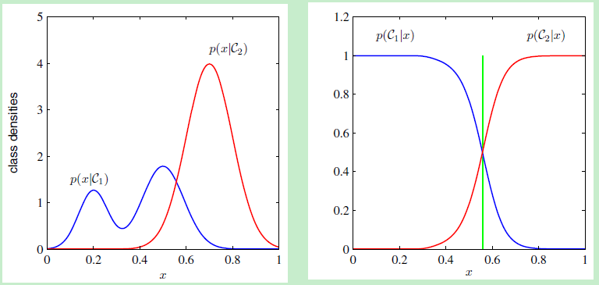
Decision theory
Three distinct approaches to solving decision problems are given, in decreasing order of complexity, by:
Compute p(x|c) and p( c ) separately, then use Bayesian theorem p(c|x) = p(x|c)p(c).
Compute the p(c|x) directly. Generative model
Find a discriminative function f(x), and map each input x directly onto a class label. Discriminative model
Corresponding to:
Left p(x|c)
Right p(c|x)
Green Line (discriminative function)

Slide 28
Decision theory
Why would we want to have access to the posterior probability?
Our goal is only to make decision, isn’t it? Is a discriminative function enough in any scenario? Think about the following 4 scenarios.
The loss changes from time to time (financial application).
Reject option ( medical expert system)
The samples in the training set is not balance (we need to compensate for class prior)
Combination of multiple models.

Slide 29
Decision theory
The loss changes from time to time (financial application).
If we have the p(c|x), we don’t need to return to the training data and solve the problem afresh.
What we need is just updating the loss. (linear or nonlinear function of t)

Slide 30
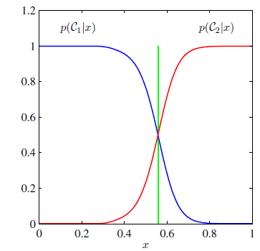
Decision theory
Reject option ( medical expert system)
Set a ratio and reject the decision with low accuracy and leave those cases to expert.
p(c|x) is obviously needed.

Slide 31
Decision theory
The training set is not balance. For example, we want to tell the criminals from crowd. The training sample set is consist of 9900 citizens without criminal record, and 100 citizen with criminal record.
To derive a good model, we need to select equal numbers of examples to make it a balance data set.
We then have to compensate for the effects of our modifications to the training data.
Suppose we have used such a modified data set and found models for the posterior probability p(c|x).
When we want to use the model to an unbalance data set. According to Bayesian theorem, we can
simply take the p(c|x) obtained from our artificially balanced data set and first
divide by the class fractions in that data set and then
multiply by the class fractions in the population to which we wish to apply the model. (fraction is prior)

Slide 32

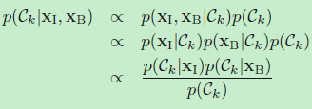
Decision theory
Combination of multiple models
Xi and Xb are independent, and we have p(c|Xi) and p(c|Xb), how would we combine these two elements. (For example, we want to make decision based on ray image and blood data )

Slide 33
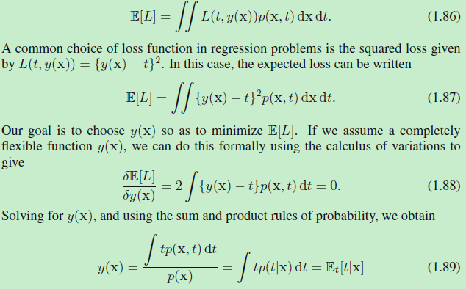
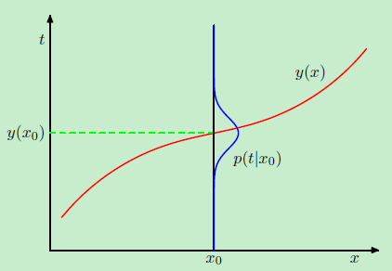
Decision theory
Loss function for regression
t ~ N(<w, x>, sigma), y=<w, x>为条件期望，作为回归值的原因。

Slide 34
Understand the probability from the point of view of Information theory
Information content h(x) = -log p(x)
p(x), p(y) if x and y are independent, then
p( x, y) = p(x)p(y)
h( x, y) = h(x) + h(y)
That is why we choose logarithm of p(x) as the expression of the information content.
x, y 的总信息等于各自信息之和（二者独立）

Slide 35
Entropy
Entropy is:
Expectation of the information content.
Average code length to transmit a message.
Lower bound on the numbers of bits needed to transmit the state of a random variable.

Slide 36
Entropy
{a,b,c,d,e,f,g,h} are the possible states of x, and each of the states is equally likely.
Entropy H(x) is -8 * 1/8 * log2(1/8) = 3 bits
The units of h are bits when the logarithm to the base of 2 is used, Nats when natrual logarithms is used to define entropy.
If the probabilities are {1/2, 1/4, 1/8, 1/16, 1/64, 1/64 , 1/64 , 1/64},

Slide 37



Entropy of continuous random variable
For discrete random variable, the entropy is maximum when the p(xi) are equal.
For continuous random variable, we can define the entropy in the following way.

Slide 38


Differential entropy
The discrete and continuous form of the entropy differ by a quantity , which diverges in the limit delta->0.
This reflects the fact that to specify a continuous variable very precisely requires a large number of bits.

Slide 39

Gaussian distribution and differential entropy
For discrete random variable, the entropy is maximum when the p(xi) are equal.
For continuous random variable, the Gaussian distribution maximizes the differential entropy and the entropy is
H increases as the variance increases (think about this).
H could be negative but entropy of discrete variable is always positive.

Slide 40


Conditional Entropy
A joint distribution p(x, y).
x is already known
The additional information needed to specify y is given by − ln p( y | x ).
The average additional information needed to specify y can be written as
The conditional entropy of y given x. 试推导

Slide 41
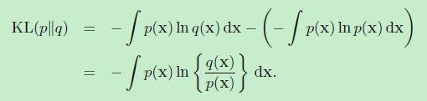
Relative Entropy
Relative Entropy or Kullback-Leibler (KL) divergence between distribution p and q.
It can be interpreted as a measure of the dissimilarity of the two distributions p(x) and q(x). Why?

Slide 42



Relative Entropy
The equality will hold if, and only if, q(x) = p(x) for all x.
This inequation could be proved using Jason’s inequality.
Here, f(x) = ln x，推导！！

Slide 43
Relative Entropy and Maximum Likelihood
Data: Generated from an unknown distribution p(x).
Approximate this distribution using q(x| θ).
One way to determine θ is to minimize the KL divergence.
We cannot do this directly because we don’t know p(x).

Slide 44


Suppose, however, that we have observed N training points Xn, drawn from p(x).
Then the expectation with respect to p(x) can be approximated by a finite sum over these points. （钦辛大数定律）
Minimizing this Kullback-Leibler divergence is equivalent to maximizing the likelihood function.

Slide 45


Relative Entropy and Mutual Information
Mutual Information between x and y.
I[x, y] >= 0 with equality if, and only if, x and y are independent.
Using the sum and product rules of probability, we see that the mutual information is related to the conditional entropy. （推导）

